Slide 1
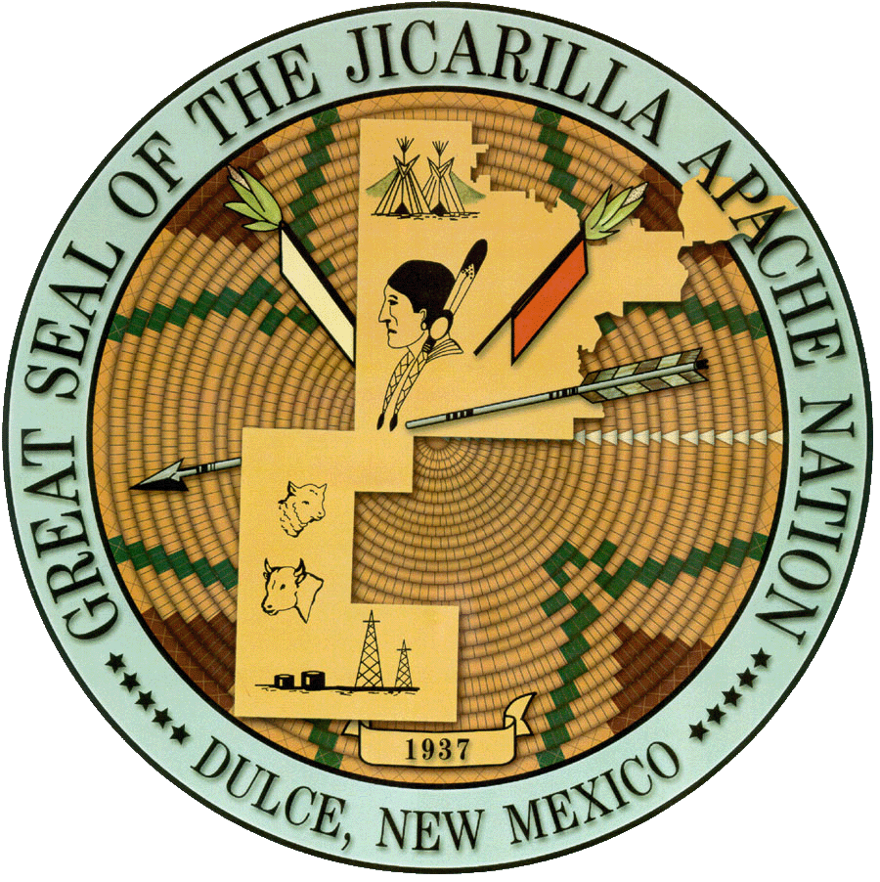
New Mexico water dialogue
January 9, 2020

Slide 2
Jicarilla Apache Nation water rights
Historic Rights
1992 Setttlement
Navajo dam & san juan chama project
Leasing ability & leasing program
Water Code & commission
2012-2013 water Auction
Current leases and SjRRIp
NGWSP

Slide 3
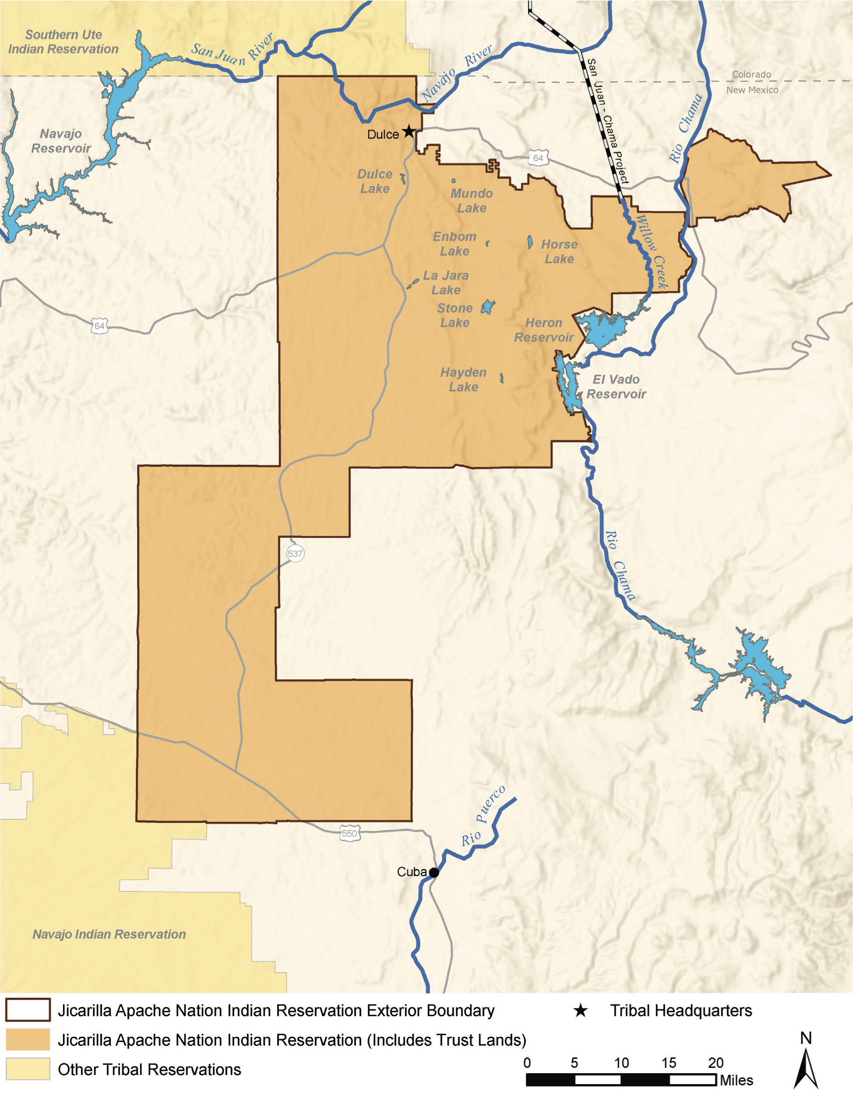
Delivery Locations

Slide 4
Ten tribes partnership of the Colorado River
Established 1992 to assist member tribes to develop and protect tribal water resources and address technical, legal, economic and practical issues related to the management and operation of the Colorado river.
Member tribes on main stem or tributaries
2.8 Million Acre-feet, 20% of the Colorado River
Joined CRWUA 1992

Slide 5
Ten Tribes Partnership
Vision Statement
Water is Life. Water the giver and sustainer of Life. Water is a sacred and spiritual element to the Tribes of the Partnership. The Creator instilled in the First Peoples the responsibility of protecting the delicate, beautiful, balance of Mother Earth for the Benefit of all living creatures. The Partnership will embrace and own the stewardship of the Colorado River and lead from a Spiritual Mandate to ensure that this sacred Water will always be protected, and be available and sufficient for each Tribes homeland.

Slide 7
Tribal Water Study
1922 Colorado River Compact
UCRC/BOr
2007 Interim Guidelines
2009-2012 basin Study
2013-2018 Tribal Water Study
2019 DCP
Equity & social justice issues
2020 Review & Evaluation of Interim Guidelines

Slide 8
Water & Tribes Initiative
Catalyzed 2108 to enhance the capacity of tribes to advance their needs and interests with respect to water management in the Colorado river basin and to advance sustainable water management through collaborative decision making
Strategic planning for the Ten tribes partnership
Leadership team
Policy briefs- Interviews
Basin wide gatherings-crwua luncheons

Slide 9
Building water Resilience for New Mexico communities
Climate change and related urgency
Understanding of tribal water rights
Forwarding and forging of collaboration and partnerships
Lessons learned from Co Basin
Creating and building a New paradigm of policy engagement
Demand Management program-NM strategic Water Reserve

