Slide 1
Water data & resilience
January 9, 2020 Water Dialogue
Stacy Timmons
Associate Director, Hydrogeology Programs
NM Bureau of Geology and Mineral Resources

Slide 2
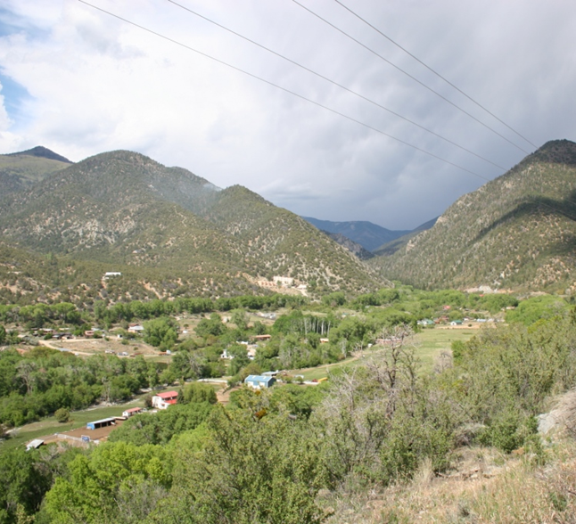
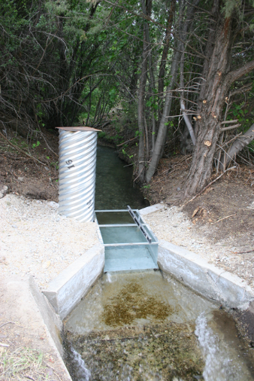
2004: Rio Hondo shortage sharing – Data!
Years of “eye ball” estimates led to fighting and violence among parciantes; challenge of managing priority rights
Installation of flume and real time data collection provides visual to enable sharing & flexibility
 | Acequia | Irrigated Acreage (acres) | Percent of Community Acreage | Flow (cfs)
 | Available Supply (USGS Valdez gage) |  |  | 40.2
 |  |  |  | Allowable diversion from the Rio Hondo
 | Des Montes Community
1 | (Cuchilla Diversion) |  |  | 16.5
1a | Rebalse Ditch | 556.3 | 40% | 6.5
1b | Des Montes Ditch | 391.2 | 28% | 4.6
1c | Acequia del Llano | 240.9 | 17% | 2.8
1ca | Mariposa Ditch | 218.9 | 16% | 2.6
 | Total | 1407.3 | 100%
 | Arroyo Hondo Community
6 | Acequia de Atalaya | 328.5 | 30% | 4.5
7 | Acequia Madre del Llano | 652.8 | 60% | 8.9
8 | Acequia de La Plaza | 106.4 | 10% | 1.5
 | Total | 1087.7 | 100% | 14.9
Data helped build consensus

Slide 3
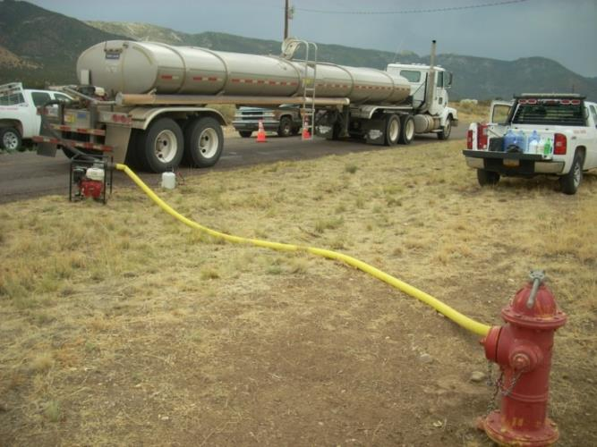
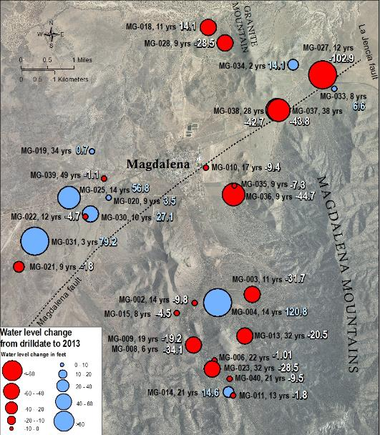
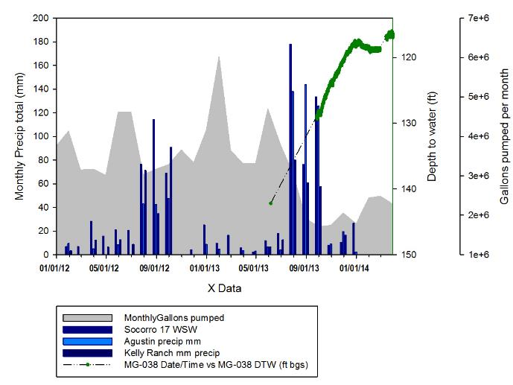
2013: A story of water data in Magdalena
Community water supply failed from only well in June
Water outage addressed with data
Crisis drives community to become more resilient
Added more wells to system
Significantly reduced water use

Slide 4
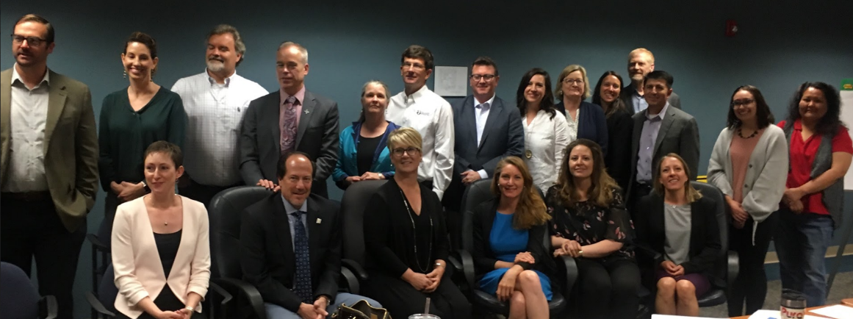
Water Data Act becomes law! (NMSA 1978, § 72-4B)
In direct support of the 2018 State Water Plan & NMSA §72-14-3.1
Enacted in 2019, from House Bill 651 (Reps. Stansbury and Armstrong)
NM agencies will share, integrate, and manage our water data
Bureau of Geology & Mineral Resources (convener)
Interstate Stream Commission
Office of State Engineer
Environment Department
Energy, Minerals & Natural Resources
Start up funding - Water Data Account
Directing Agencies May 2019

Slide 5
What is water data?
Water data: measurements of basic properties relating to the planning and management of water resources, including water quantity, quality and use.
Water Quantity
Streamflow, lake levels, groundwater levels, soil moisture, and weather (precipitation, snow, evapotranspiration)
Water Quality
Constituents in water; parameters like temperature, dissolved oxygen, pH, nutrients, specific conductance, turbidity, and ecosystem health data.
Water Use
Water withdrawals, consumption, discharge / return flows, transfers, reclaimed water

Slide 6
Data vs. Information
DATA
are the facts, the measurements, the building blocks
INFORMATION
data that has been interpreted, modeled or synthesized to answer specific questions or for particular applications

Slide 7
Photo courtesy of Christi Bode

Slide 8
Tremendous progress on a multiyear effort
Identified preliminary Key Data from data inventory for selection of initial data sets for upload to online water data service,
Developed Draft Key Data Criteria based on the New Mexico Office of the State Engineer’s 2018 State Water Plan and NM First Town Hall (2017, Albuquerque) on water planning; and
Set up a team that is developing a robust Key Data and Tool selection process based on User and Technical group inputs.
Defined focus of this activity to address essential descriptions (metadata) of data, rather than data collection (i.e. sampling) procedures;
Initiated development of water data standards through the technical work group, and
Created metadata form for uniform data identification and searching.
Interviewed several platform providers and experts; selected the initial water data software/platform (CKAN),
Contracted with University of New Mexico’s Earth Data Analysis Center to provide data service set up and IT support, and
Launched initial Water Data Service with map and preliminary data catalog (newmexicowaterdata.org).
Acquired an inventory of “available” NM data from Internet of Water, and
Performed initial inventory of digitally available and unavailable water data from New Mexico state agencies.

Slide 9
Governance
DIRECTING AGENCIES TEAM
Agencies in legislation (or directly related) that collect, publish, and maintain data, and will work to integrate data and implement water data standards.
Initial Tasks: Help set goals and metrics, determine priority needs and key data, assist with communications and data inventory in agency, help with reporting
NMBGMR
NM ISC
NM OSE
NMED
EMNRD
NMDGF
Established governance for effort
Implementation team established
Hired staff to support convening tasks
Developed vision and goals for long-term success
With support from:
Internet of Water, at Duke University
Sandia National Laboratories
Earth Data Analysis Center, UNM
IMPLEMENTATION TEAM
Stacy Timmons
NMBGMR, ISC, SNL
Initial Tasks: Provide oversight, convene and organize groups, guide strategy and direction, assist with finance / procurement, reporting
TECHNICAL WORK GROUP
Technical staff or researchers that collect, publish, and maintain data. Research, database, IT or GIS roles.
Initial Tasks: Guide development of data standards, help evaluate technical needs/software, help complete data inventory, share and maintain data
DATA USERS WORK GROUP
Stakeholder and data users, may include water planners, water managers, policy makers, researchers
Initial Tasks: Articulate users needs, provide recommendations and feedback, develop use case scenarios.

Slide 10
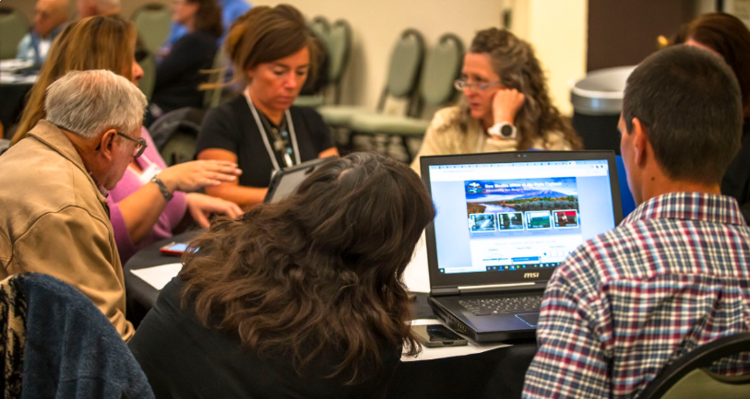
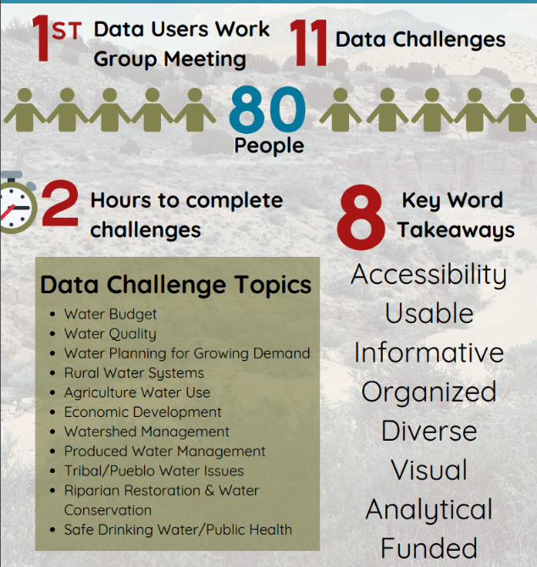
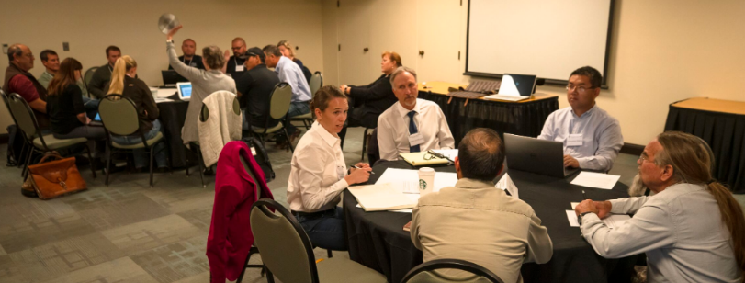
Stakeholder engagement
Hosted the first Water Data Workshop (Oct. 24, 2019) for all interested parties to learn and contribute to the future for water data in New Mexico

Slide 11
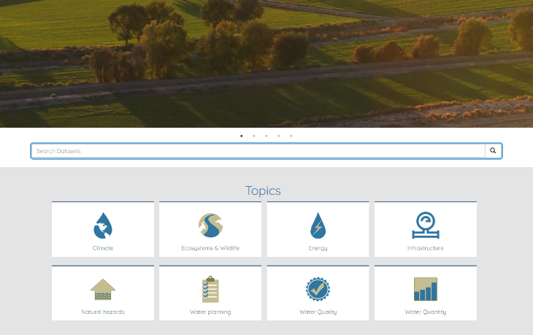
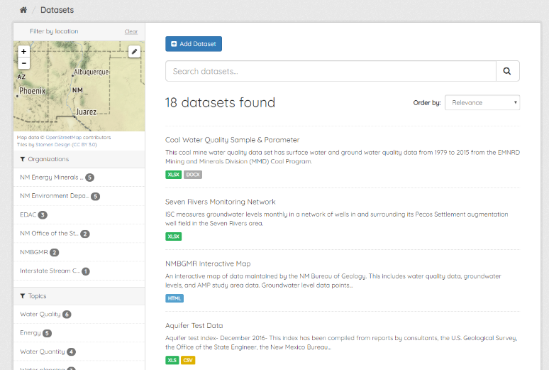
newmexicowaterdata.org
Our initial catalog – open source software (CKAN)

Slide 12
Future of NM Water Data
Build / improve data service and bring in additional data providers
Begin pilot studies to utilize data for decision making, water management and planning – use cases
Develop plan for legacy data
Coordinate with / support other initiatives
New Mexico 50-year Water Plan
Rio Grande Basin Study (US BOR)
Improve multi-agency coordination
Raise funding
Photo courtesy of Christi Bode

Slide 13
What can data do to build water resilience?
Resilient water challenges
Water data opportunities
Build redundancy in sources
Increase flexibility
Rapid forecast future conditions and decision making
Water quantity / water supply
Groundwater / surface water
Water quantity data; Conservation; sharing options
Real-time data & tools

Slide 14
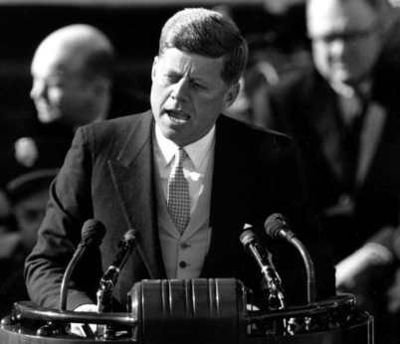
As we set goals of resilience, it can help drive our water data priorities
Ask not what water data can do for resilience, but what resilience can do for water data!

Slide 15
Stacy.Timmons@nmt.edu
NewMexicoWaterData.org

