Slide 1
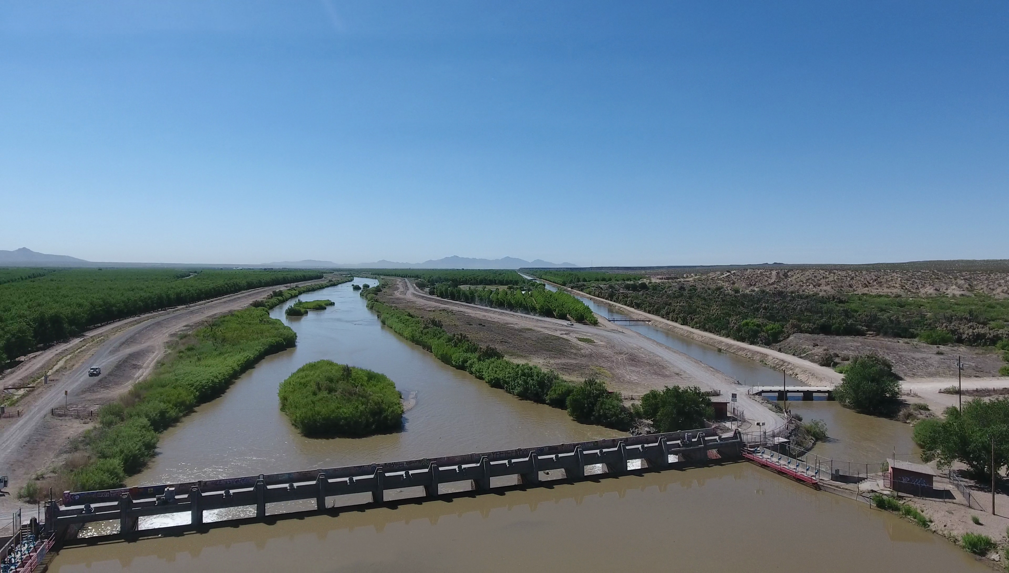


Resilient Water Management in Practice:
A Lower Rio Grande Perspective
J. Phillip King, PE, Ph.D.
Professor and Associate Department Head
Department of Civil Engineering, New Mexico State University
Consultant, Elephant Butte Irrigation District
jpking@nmsu.edu
9 January 2019

Slide 2
Resilient /ri-ˈzil-yənt/ adjective
: characterized or marked by resilience: such as
a: capable of withstanding shock without permanent deformation or rupture
b: tending to recover from or adjust easily to misfortune or change*
*Merriam Webster https://www.merriam-webster.com/dictionary

Slide 3
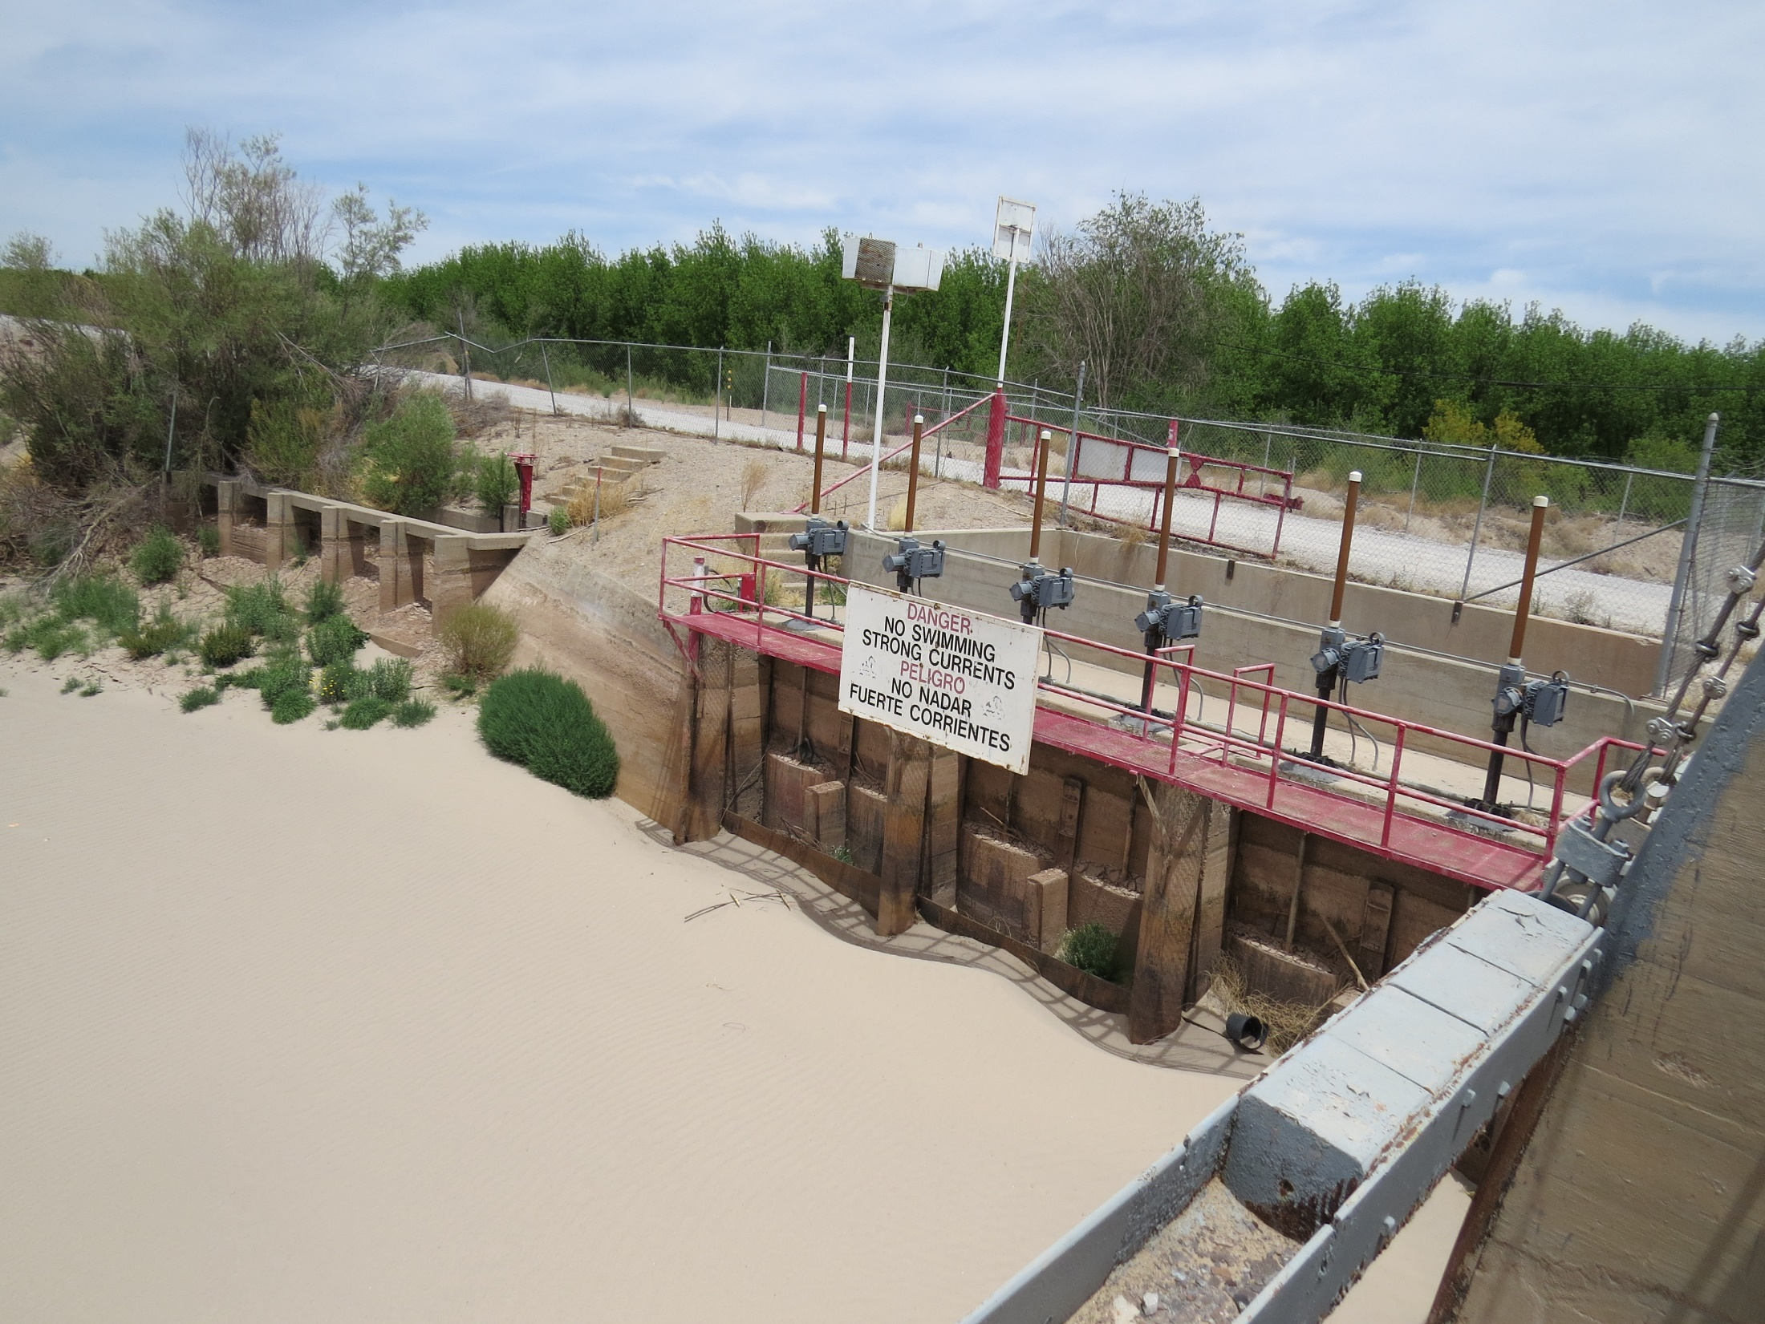
The Big Question:
Q: Do you really want to hear from a Lower Rio Grande guy about Resilient Water Management in Practice?
A: Yes. We have seen shock, misfortune, and change. We are adapting because things are getting bad enough.

Slide 4
Challenges facing LRG
Multidecadal drought
Increasingly arid climate
Hydrologic effects of drought and climate change passed disproportionally downstream
State law adjudicates to highest year’s use
Adjudication doesn’t establish resiliency – it tells people in what order they will be cut off
Municipal and Industrial water use on an increasing trend
Agriculture is getting more efficient and higher in unit area depletion – also higher yields and more revenue
Depletion reduction

Slide 5
The Vicious Circle:
Short surface water supply leads to reduced aquifer recharge and more groundwater pumping in agricultural and M&I systems – a “Double Whammy” on the groundwater system
Impaired groundwater system leads to greater surface water losses
Greater surface water loss leads to reduced surface water supply
GOTO 1

Slide 6
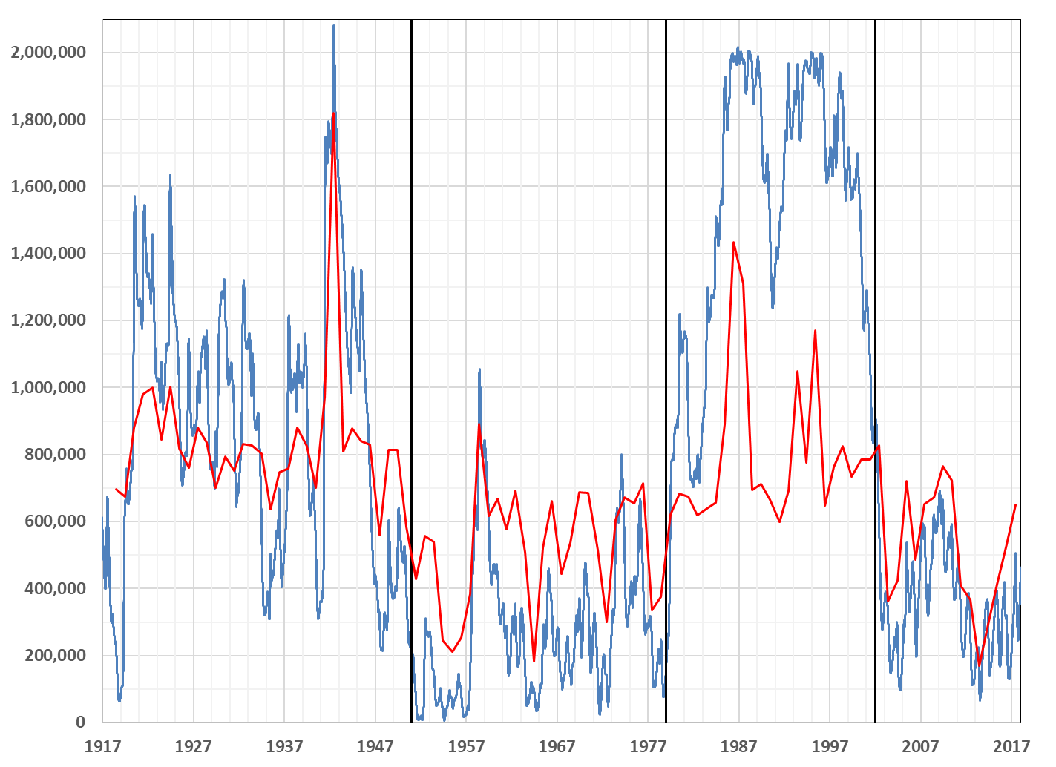
Rio Grande Project Hydrologic History: Elephant Butte Reservoir
1916-1950:
Plentiful Supply
1951-1978:
Drought I
1979-2002:
The Wet Years
2002-2017:
Drought II
Annual Release
Storage

Slide 7
Groundwater Elevation in the Mesilla Valley, 1946-2015
Peggy Johnson, NMT/NMBG 2015

Slide 8
Resilient
Water
Management
GW Management
Alternative
Sources
Tiered Status Indicators
Import
Desal
SW Treatment
Flood Cap
Offsets
M&I -
FDR -
Buy & Dry
Ag H2O
Aq Recharge
Dir Use
Rotational
Fallowing

Slide 9
Potential Tiered Status Indicators
Groundwater Level Index
Diversion Ratio
  Annual RGP Charged Diversions ÷ Caballo Release
Annual Release from Storage
Annual Allotment to EBID
They are all highly correlated

Slide 10
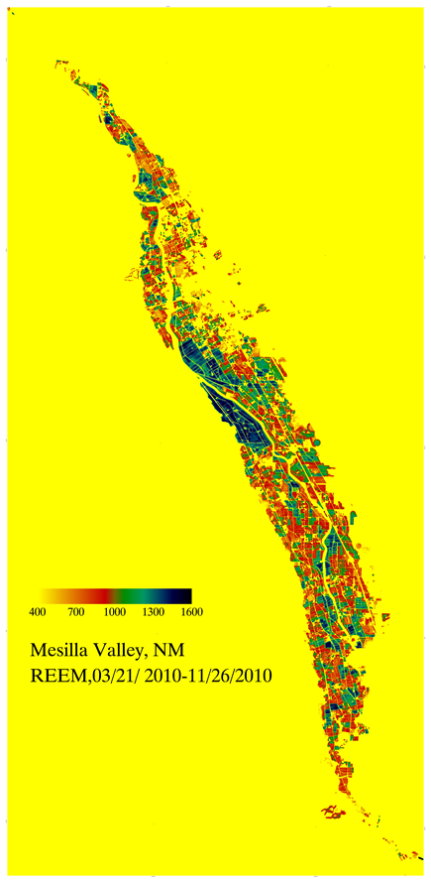
Depletion Reduction – A tough pill to swallow
Lower water use crops – market driven
Deficit Irrigation – reduced yield
Fallowing – reduced production, lost revenue
  Voluntary fallowing
  FDR reduction
  Paid rotational fallowing
  Buy & Dry permanent fallowing
  Effects of fallowing on viability of agriculture as an industry
Z. Samani

Slide 11
Bottom Line: No crisis should go to waste
Vicious circle, litigation, internal disputes may finally be bad enough to get something done
Planning for resiliency must be adaptive, and sufficiently effective to avoid “deformation or rupture.”
Increasing pressure on resources requires increasingly intelligent and creative management
Stay tuned …

