Slide 1

How Clear is the Climate Change Crystal Ball?
David S. Gutzler
University of New Mexico
gutzler@unm.edu
What do we know?
What is uncertain?
What do we do about it?
Water management challenges
NM Water Dialogue
9 January 2020

Slide 2
Temperature and Precipitation in NM
large,
ongoing trend
no long-term trend
lots of variability
2/14
updated from NM Water Supply Vulnerability Working Group (2015)

Slide 3
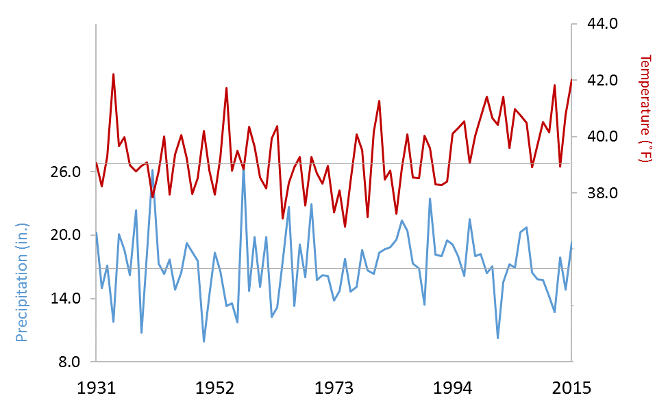
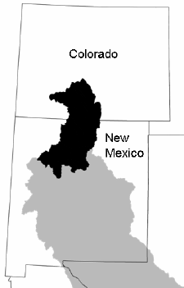
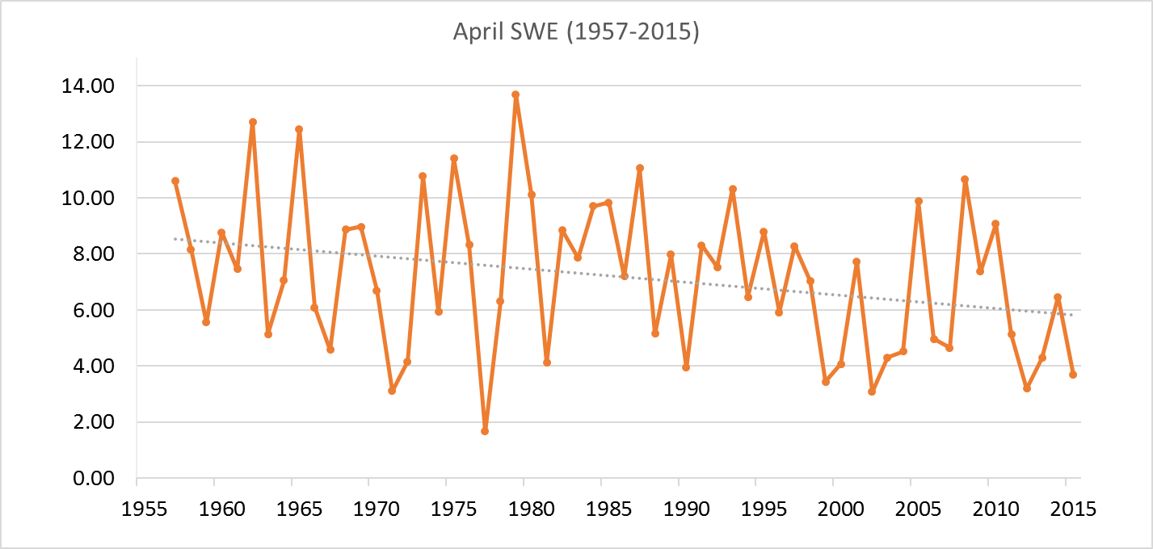
Observed Climate Variability in the RG Headwaters
º
Temperature and Precipitation
CO Division 5
Temp ( F)
→ Temperature has
increased ~3 F since
the early 1970s
→ Very small increase in
precipitation (natural?)
o
Inches
Precip (in)
1 April Snowpack
Upper Rio Grande basin
SWE (in)
5
Inches
→ Snowpack has
decreased ~25% since
the early 1970s
3/14
Chavarria & Gutzler (2018) from NOAA and NRCS data

Slide 4
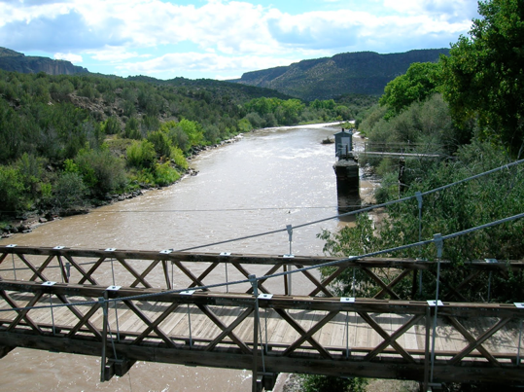
Proxy Rio Grande streamflow: Otowi gage
based on
tree ring data
±20%
~1700 kAF/yr
average
Otowi gage
1500
2000
Huge multidecadal fluctuations in
precipitation and streamflow
treeflow.org
Gutzler (2012)
4/14
Notes:
4

Slide 5
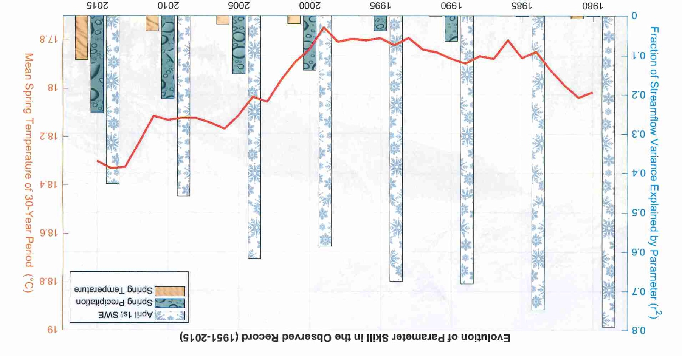
Diminishing Hydrologic Importance of Snow
Importance for streamflow prediction
Red line: Mean Spring Temperature
1951-
1980
1961-
1990
1971-
2000
1981-
2010
5/14
Bjarke & Gutzler (2020)

Slide 6
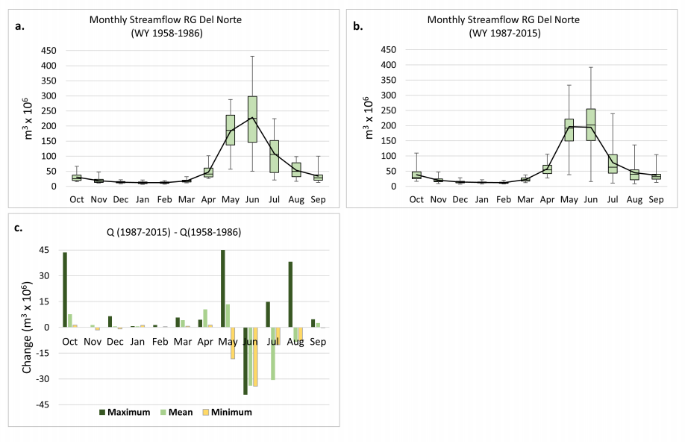
Upper Rio Grande Hydrograph Changes (Observed)
1958-1986
1987-2015
* Very little change in total discharge
* Shift in the runoff peak to earlier months
Chavarria & Gutzler (2018)
6/14

Slide 7
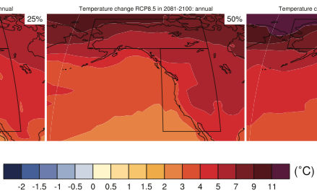
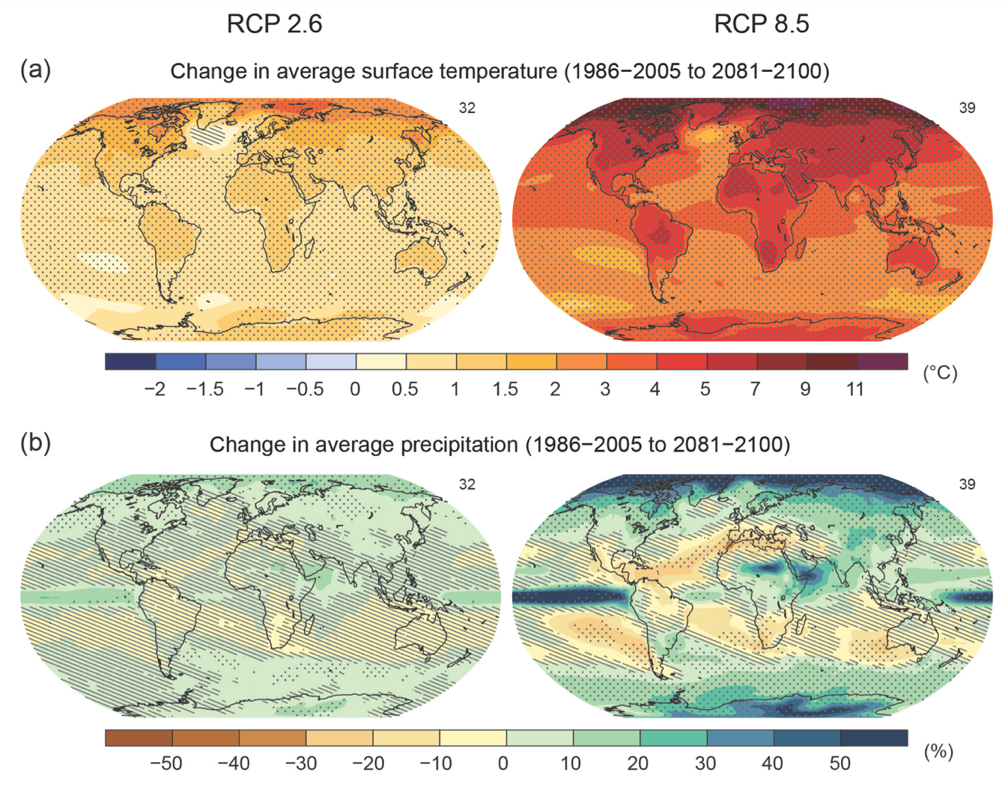
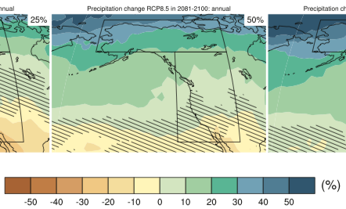
Projected 21st Century Changes
Low Emissions
RCP2.6
High Emissions
RCP8.5
Continental and polar
enhancement of projected warming
TEMPERATURE
"Wet gets wetter
Dry gets drier"
PRECIPITATION
…. subject to large
quantitative uncertainty
7/14
IPCC AR5 (2013)

Slide 8
Increasing Frequency of Extreme Precipitation
baseline
1901-1960
Robust projections of more variable precipitation, regardless of changes to average precip
8/14
Janssen et al. (2014)

Slide 9
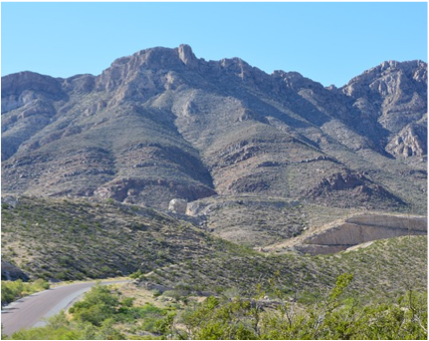
Projected Climate Change: Warmer
model-based
projection
2008-2100
data
1901-2007
summer
~ 4 C/century →
o
Franklin Mountains
(outskirts of El Paso TX)
winter
˜
Espanola Valley
1900
2000
2100
By the end of the 21st Century:
T (Albuquerque) → current T (El Paso)
T (Taos) → current T (Espanola)
˜
9/14

Slide 10
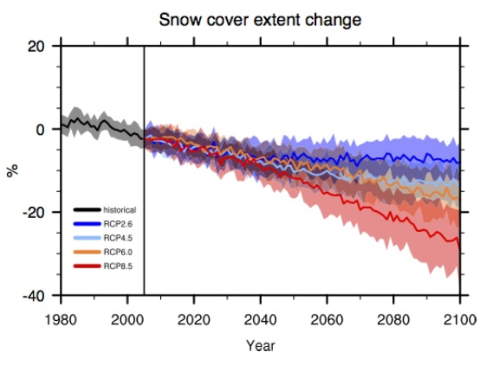
How much snow can we expect in a warmer climate?
CMIP3
CMIP5
Brutel-Vuilmet et al. (2013)
Brown and Mote (2009)
1980 2020 2060 2100
IPCC Assessment: "Medium Confidence"
Large projected decrease in mean winter snowpack
Diminished snowpack also melts earlier in the year
10/14

Slide 11
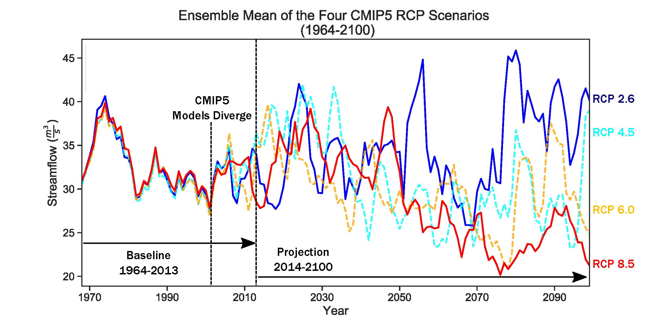
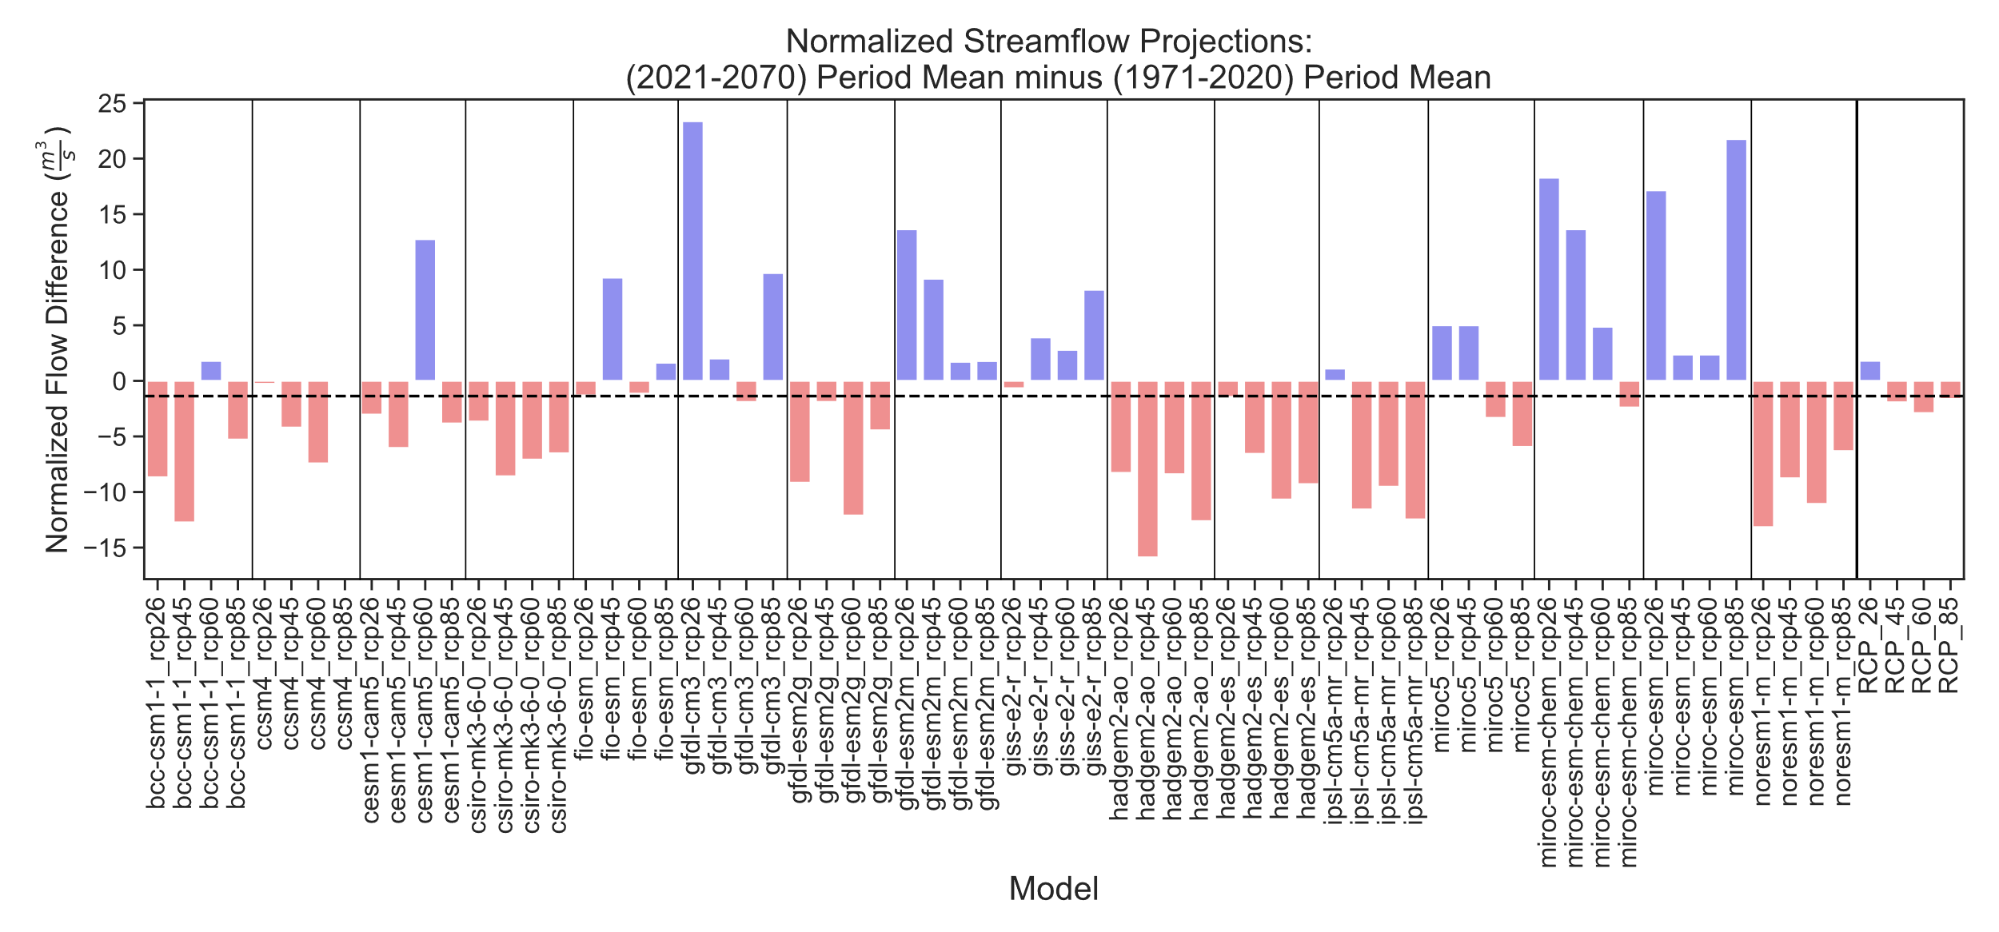
Projected streamflow changes: RG at San Marcial
Emissions dependence does not emerge until late 21st Century
RCP-mean
changes
1971-2020
2021-2070
}
Huge variability in projected change (in 50-year averages) among simulations
US BoR projections, adjusted by Townsend & Gutzler (2020)
11/14

Slide 12
Stock-Taking: Status of global
emissions reduction efforts
There are huge gaps between:
Actual energy production plans
Stated emissions pledges
Calculated reductions needed to limit climate change
(7.6%/yr reduction now required to achieve 1.5◦C limit)
Economist 22 Nov 2019
12/14

Slide 13
Responding to Climate Change: Need to Adapt
Temperature is increasing, snowpack is decreasing, for sure
Precip trends are less certain, with high interannual variability
Precipitation events are becoming more extreme
Snowmelt runoff is changing
→ Snowpack is already decreasing and melting earlier
Droughts (precip deficits) are worsened in a warmer climate
→ This may be the greatest impact of regional climate change
→ Expect increasing pressure on water resources during
droughts
13/14

Slide 14
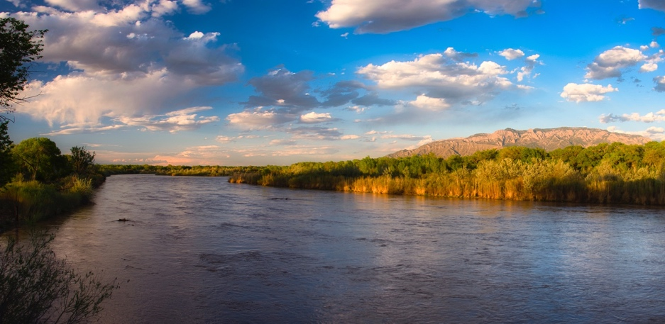
So What To Do About Diminishing Surface Water?
New Mexicans need to adapt to a hotter & drier climate, with a trend toward a weaker, earlier snowmelt runoff peak
... but also: more intense, extreme precipitation and local flooding events
Streamflow projections for major snowmelt-dominated rivers are still highly uncertain! But risk management dictates planning for diminished flows and more intense shortages during drought episodes.
Policies to mitigate greenhouse gas emissions have been adopted and will be implemented sooner or later, but policy on a global scale has not yet reduced emissions
Climate change is an added stress on surface water resources, on top of other management challenges
Rio Grande at Albuquerque
26 April 2019
14/14

Slide 15
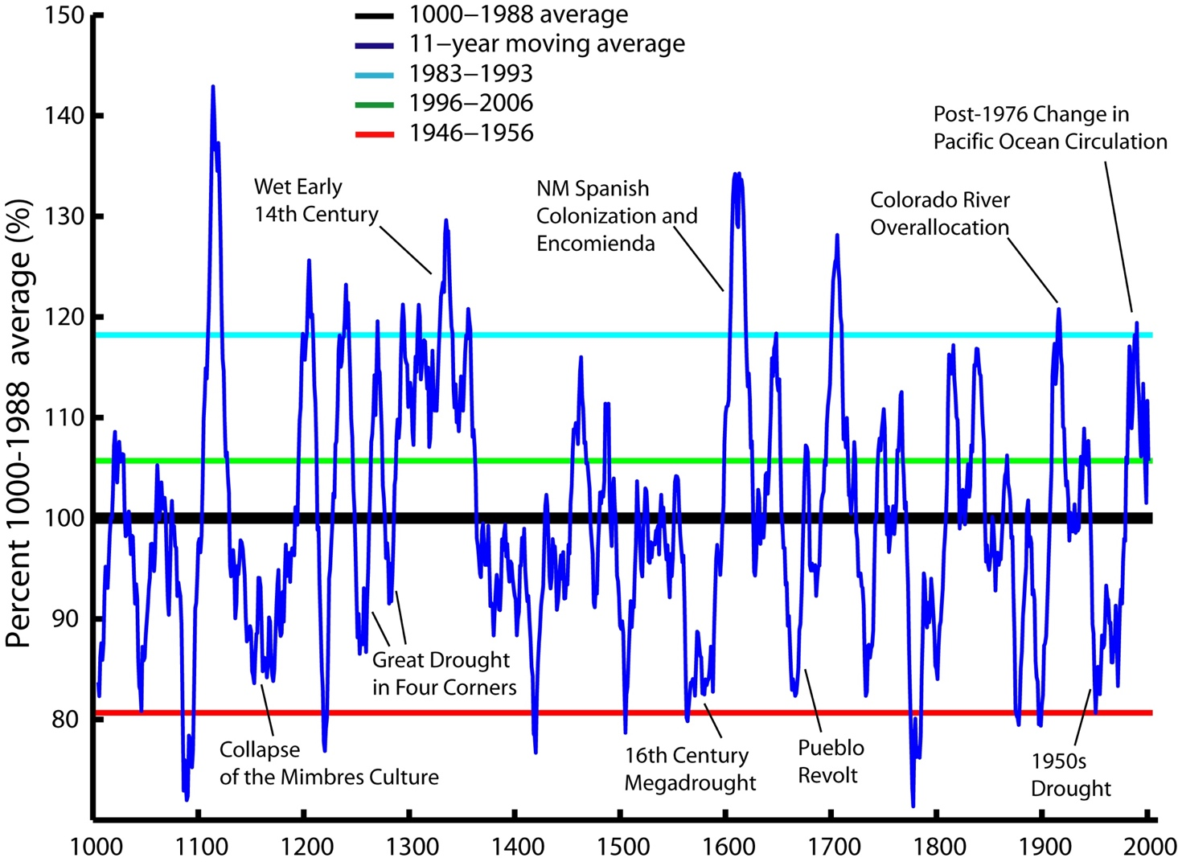

Reconstructed precipitation variability, northern NM
140%
based on
tree ring data
NM Climate
Division 2
80%
Taos Pueblo
1000
1500
2000
NMOSE (2006), from
G. Garfin (U. Arizona)
±20% changes on decadal time scales is typical
Notes:
15

Slide 16
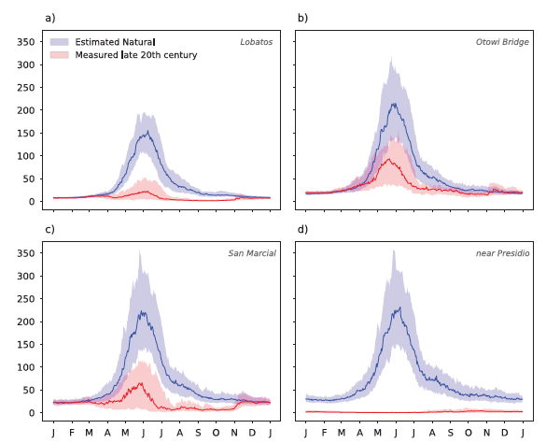
Where does the Rio Grande’s water go?
Rio Grande flow, late 20th Century [m³/s]
Lobatos
Otowi
We take out most of the water in the river for multiple uses
... but mostly for
agriculture
San Marcial
Presidio TX
Blythe & Schmidt (2018)

Slide 17
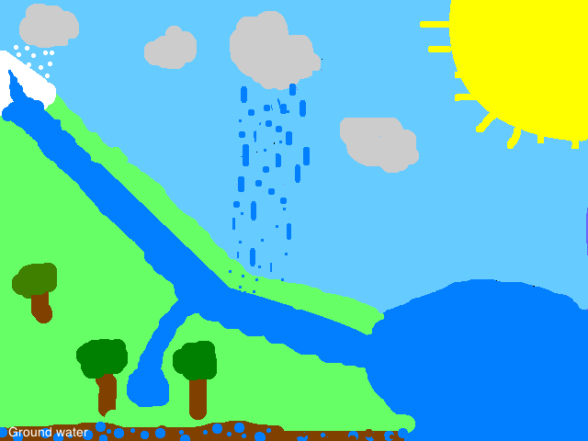
Precipitation and Streamflow in Mountainous, Middle-Latitude Terrain
snow rain
snow → winter snowpack
→ convenient, low-loss seasonal storage
→ predictable snowmelt runoff
large-scale rain (winter, spring, autumn)
→ falls over a wide area
→ maybe some seasonal
predictability
gage/
ditch
storage
convective rain (summer thunderstorms)
→ minimal predictability, spotty
→ high E: low recharge, flashy runoff
For surface water resource management,
not all precipitation is created equal

Slide 18
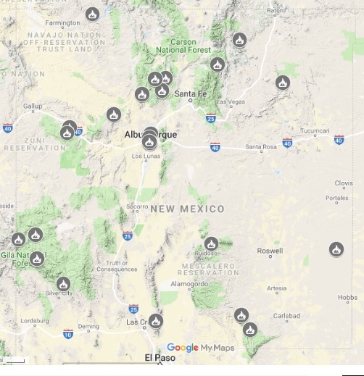
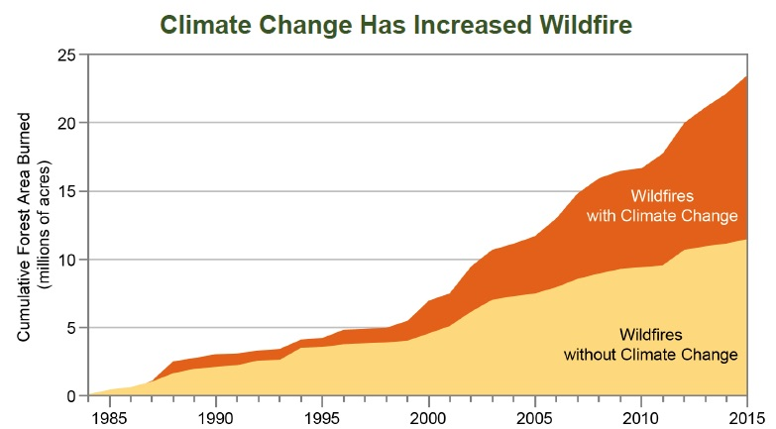
Wildfire Risk is Increasing
NM Wildfire Map (2018)
US National Climate Assessment (2018)
1985 1995 2005 2015
Forested lands are critical for watershed health

Slide 19
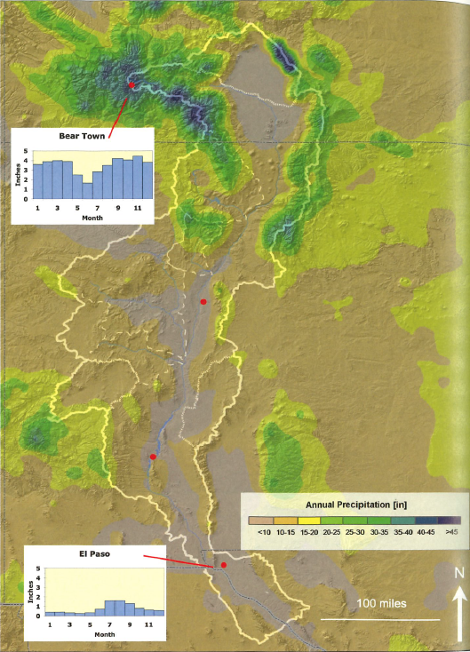
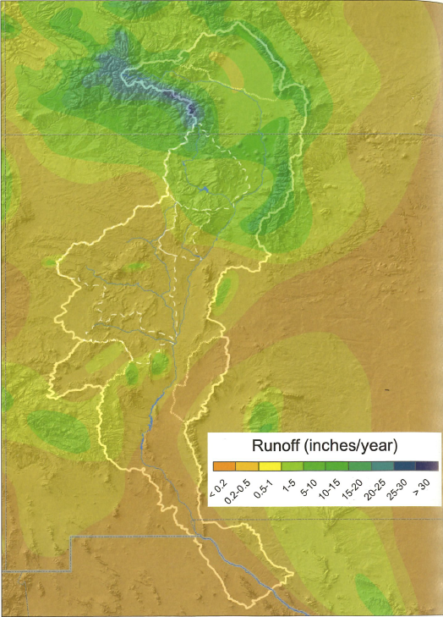
Where does the Rio Grande’s water come from?
Annual Precipitation
Runoff Generation
CO
(snow)
Taos
Santa Fe
(rain,
or not)
NM
Albuquerque
Elephant Butte
El Paso/Juarez
CH
TX
Phillips et al. (2011)

Slide 20
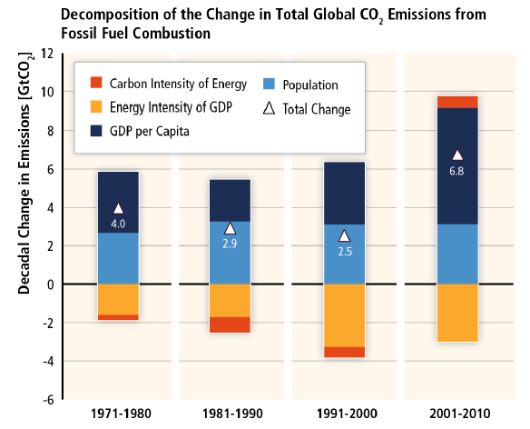
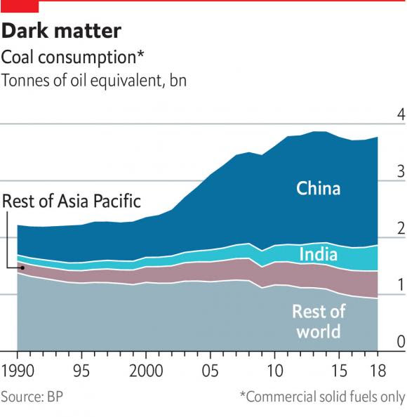
Carbon emissions and coal consumption
IPCC AR5 WG3 (2014)
Economist (Sep 2019)
Huge increases in coal consumption are occurring in Asia .... and not in the rest of the world.
Rapid development of cheap, dirty energy has contributed to raising living standards in Asian countries – at a steep environmental cost.

Slide 21
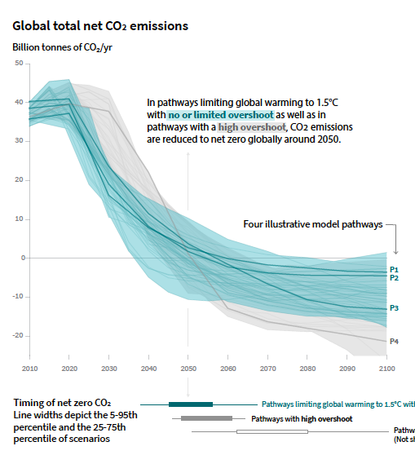
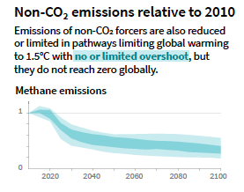
The urgency of emissions mitigation
2020 2060 2100
Decades of global non-action on
emissions mitigation have closed the window on further delays
Meeting the Paris climate goal requires steep reductions in all fossil fuel emissions ... soon
2020 2060 2100
IPCC (2018)

Slide 22
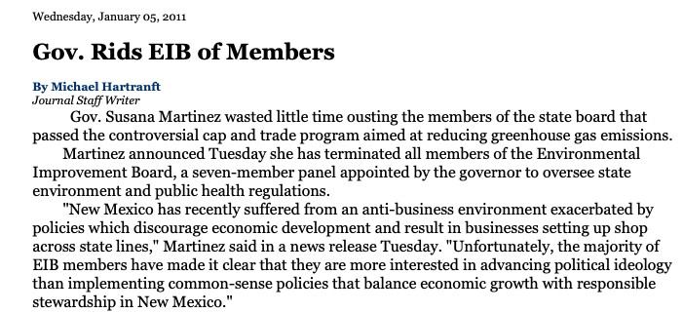
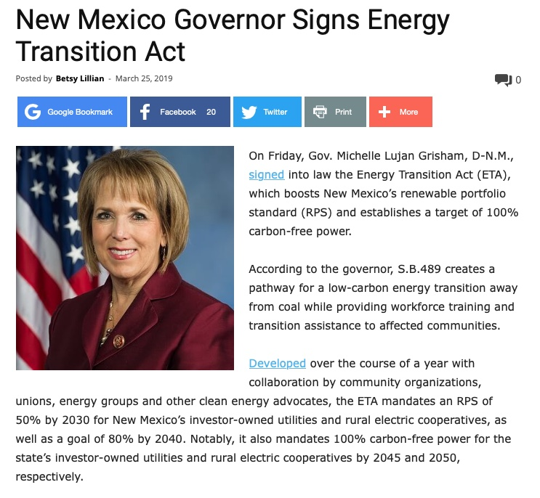
Mitigation of Climate Change:
Controversial, but Inevitable
Jan 5, 2011
Mar 25, 2019

